Slide 1

Indian Sign
Language Recognition
Summer Project
By – Ashish Singla
00520902719
5th SEM, CSE
JANUARY, 2022

Slide 2
ABSTRACT
Communication is a basic prerequisite for an individual to express feelings, thoughts, and ideas, yet the vast majority of individuals find it difficult to interact with the hearing and speech challenged community. Hearing and speech disabled people can engage with the rest of society through sign language. The Indian government has passed the Rights of Persons with Disabilities (RPWD) Act, 2016, which acknowledges Indian Sign Language (ISL) and requires the use of sign language interpreters in all government-aided organizations and public sector proceedings.
5

Slide 3
PROBLEM
Unfortunately, a large percentage of the Indian population is not familiar with the semantics of the gestures associated with ISL.

Slide 4
01
PROBLEM vs SOLUTION
What could be the solution for this ?

Slide 5
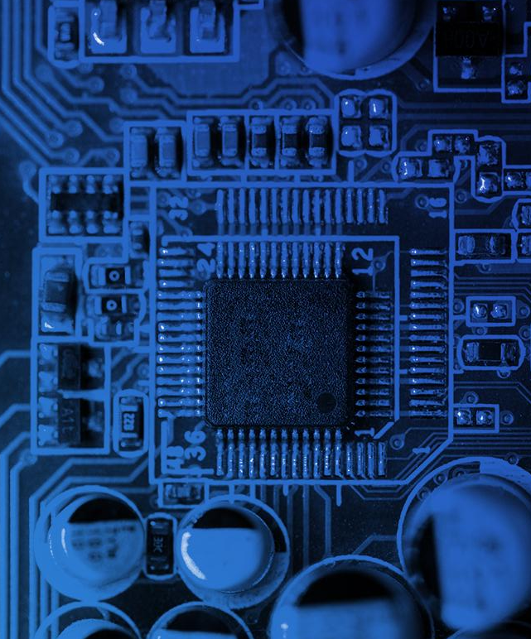
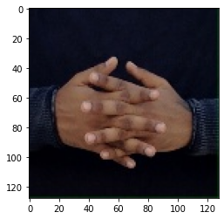
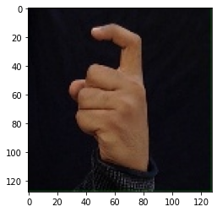
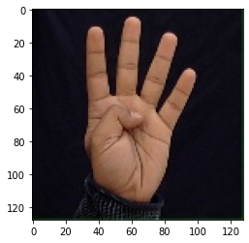
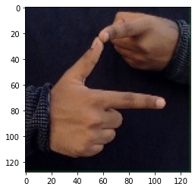
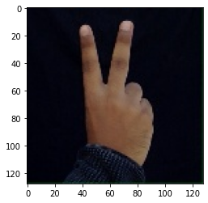
W
7
4
To bridge this communication gap, this project develops a model that uses Convolutional Neural Networks to detect and classify Indian Sign Language.
The model seeks to categories 36 ISL gestures representing 0-9 digits and A-Z alphabets by converting them to their text equivalents using OpenCV and Keras implementation of CNNs. The developed and used dataset consists of 350 photos for each gesture, which were input into the CNN model for training and testing. The model was successfully implemented & achieved 99.03% accuracy for the test images.
J
2

Slide 6
AWESOME WORDS!
Neural Network
CNNs
Training
Keras
99.03% Accuracy
Model
What do they mean ?

Slide 7
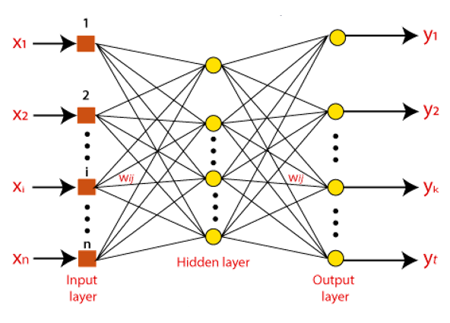
02
NEURAL NETWORKS
Neural networks are a class of machine learning algorithms used to model complex patterns in datasets using multiple hidden layers and non-linear activation functions.
Neural networks are artificial systems that were inspired by biological neural networks. These systems learn to perform tasks by being exposed to various datasets and examples without any task-specific rules.

Slide 8
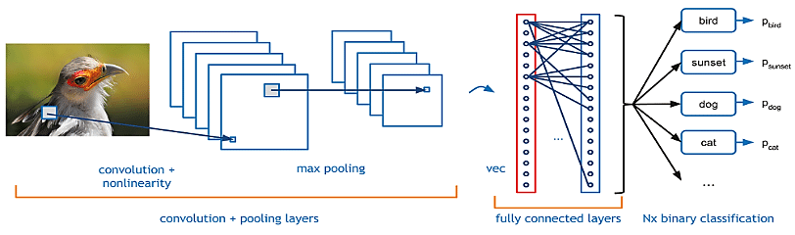
03
CONVOLUTIONAL NEURAL NETWORKS
A convolutional neural network (CNN) is a type of artificial neural network used in image recognition and processing that is specifically designed to process pixel data. A neural networks a system of hardware and/or software patterned after the operation of neurons in the human brain.

Slide 9
NOW, BACK TO THE MODEL !
Pre – Processing, Training, Testing and Results

Slide 10
04
PRE - PROCESSING
Before designing and training a Convolutional Neural Network (CNN), the dataset was loaded and the images were resized to 128 x 128 pixels.
Then the data was split into 2 sets; the Training data which was 80% of the whole dataset and the Test data which was the remaining 20%. Once the dataset was pre-processed, it was ready to be fed into the CNN model along with their class labels.
The model comprised the following layers:
• Convolutional Layers
• Max Pooling Layers
• Dropout Layer
• Fully Connected Layers (Dense Layers)

Slide 11
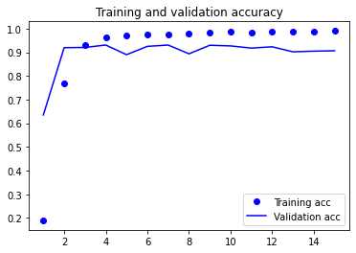
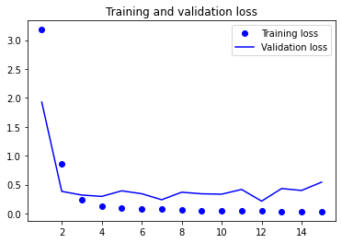
TRAINING
05
After the model was successfully compiled, we fit the model on the training dataset for 15 epochs using the two training callbacks discussed above and with a 10% validation data split. The model was saved after training was over.

Slide 12
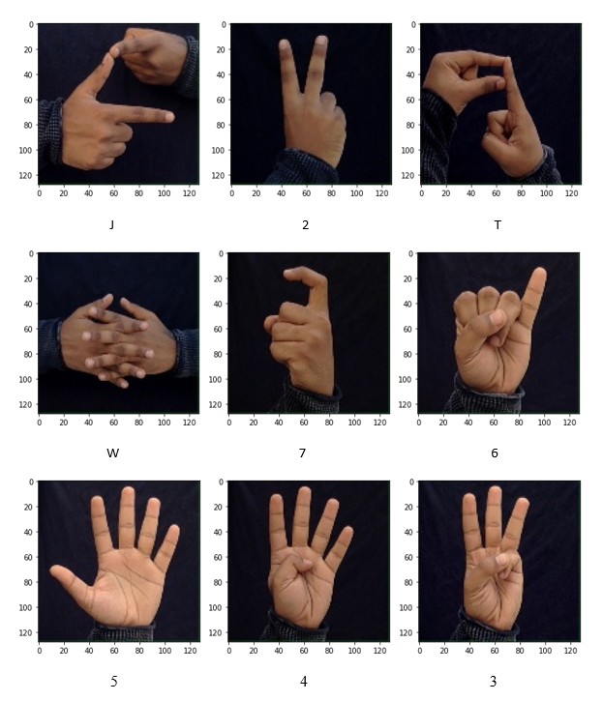
TESTING
06
The model was trained and tested on 350 images of each ISL alphabet and numeral sign. A collection of 10800 randomly selected images out of the total 12600 images were fed into the model for training. Some testing outputs are:

Slide 13
WHAT ARE THE
RESULTS ?
07

Slide 14
RESULTS
TRAINING ACCURACY
99.03%
VALIDATION ACCURACY
90.65%
LOSS VALUE
0.032
CORRECTLY CLASSIFIED
1782 / 1800 IMAGES
The model achieved 90.65% validation accuracy. Post training, the model was tested on 1800 test images, and an accuracy of 99.03% and a loss value of 0.032 was obtained, with the model correctly classifying 1782 test images out of the total test dataset of 1800 images.

Slide 15
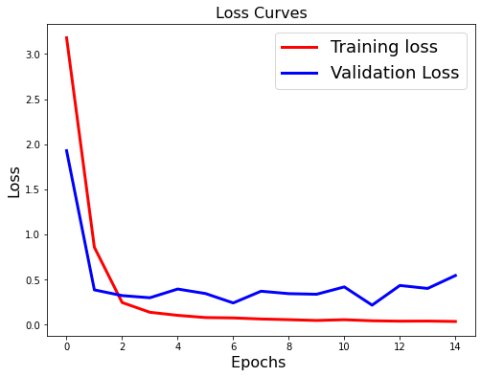
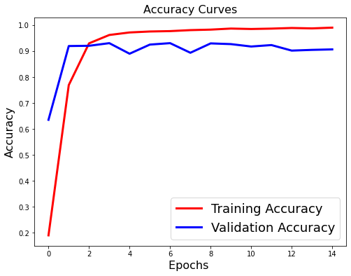
CURVES

Slide 16
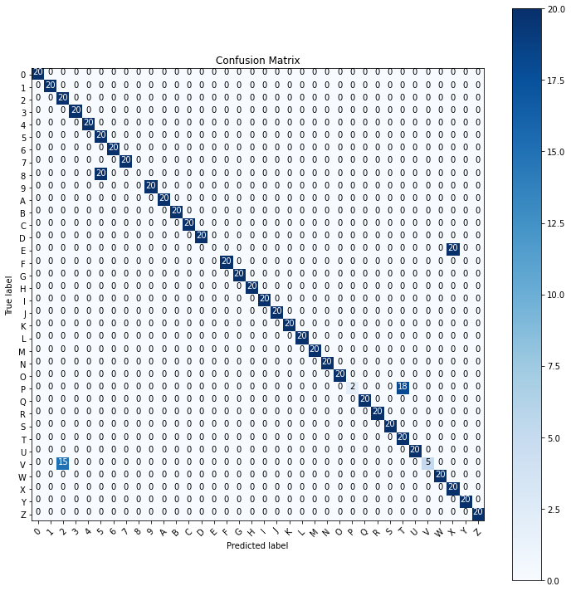
CONFUSION
MATRIX

Slide 17
Thank You
Thus, the proposed CNN model was successfully implemented and achieved 90.65% validation accuracy on the training images. On testing the model on test data, an accuracy score of 99.03% was obtained.
Such a sign language recognition system can prove to be very helpful for the deaf and dumb population of the country in communicating with others.
@ashishsingla0012
Ashish Singla
00520902719
5th Sem, CSE
G.B. Pant Govt. Engineering College

